Slide 1
Reminders
Final Project idea submission due tonight
Threading homework due tonight
Quick discussion on that

Slide 2
Winforms & Sudoku

Slide 3
Toolbox Demonstration
Button
Checkbox
ComboBox
DateTimePicker
Label
PictureBox
TextBox

Slide 4
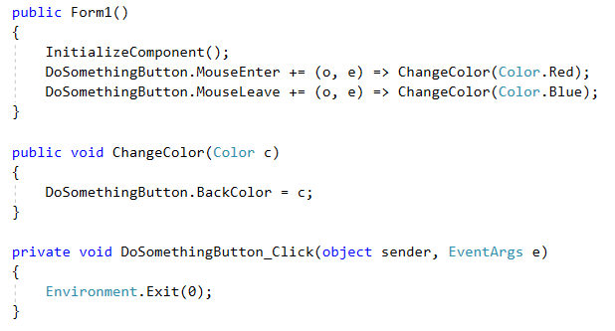
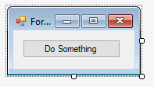
Button
Make the button do something
In this case, create a click event and use it to close program
MouseEnter/MouseLeave events with lambda expressions
Change the backcolor of the button with events

Slide 5
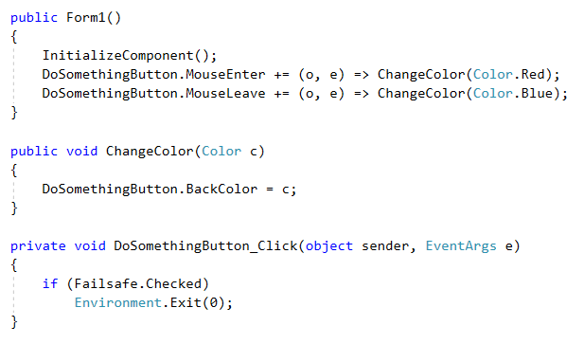
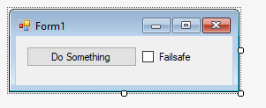
Checkbox
Make our button only work when the “failsafe” checkbox is checked.

Slide 6
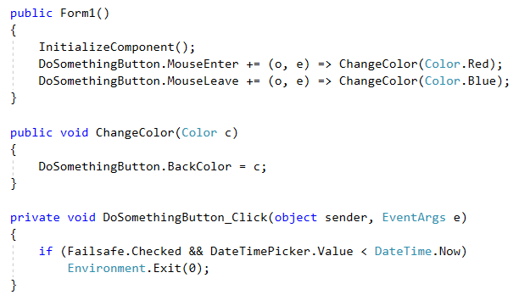
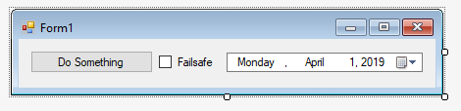
DateTimePicker
Modify our button to only work when our date is set to a date previous to today.

Slide 7
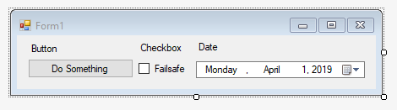
Label
Simply used to label things

Slide 8
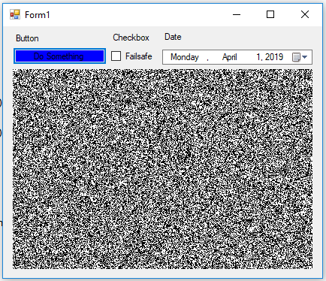
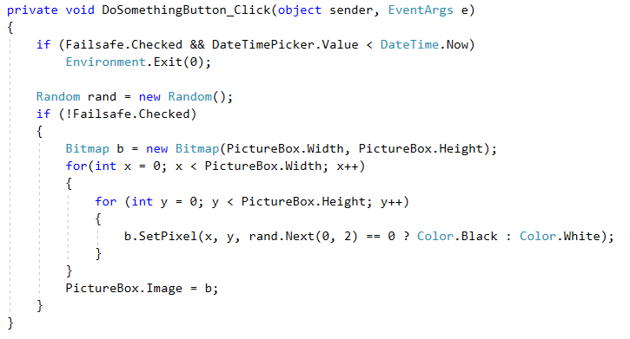
PictureBox
Make button randomly change colors of picture box if failsafe is not checked.

Slide 9
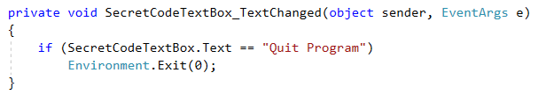
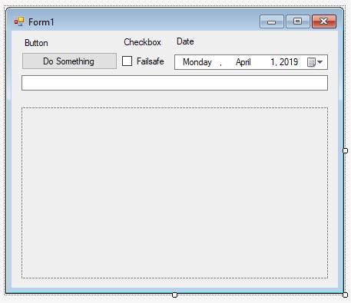
TextBox
TextChanged event

Slide 10
Real Example Projects
FileManipulationSuite
InfiniteCampusInput
SecurityCameraSystem
Swagger

Slide 11
Winforms Homework
Develop Sudoku in a Winforms application with the following:
Generate random board
Load board from file
Solve current state
Check current state

Slide 12
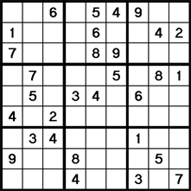
What is Sudoku?
A puzzle in which players insert the numbers one to nine into a grid consisting of nine squares subdivided into a further nine smaller squares in such a way that every number appears once in each horizontal line, vertical line, and square.

Slide 13
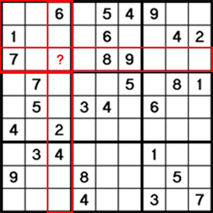
SudokuBoard.VerifyBoard()
This method does it’s rounds on the board to check to see if the board is completed.
Optional, adjust solution to decide which is true:
Valid, Solved
Valid, Unsolved
Invalid
Must check:
Row
Column
Square

Slide 14
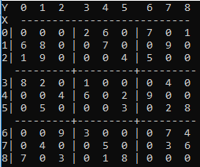
Checking the square
https://docs.microsoft.com/en-us/dotnet/csharp/language-reference/operators/remainder-operator
% = modulus operator
5 % 4 = 1
3 % 4 = 3
8 % 3 = 2
So how do we check the square?

Slide 15
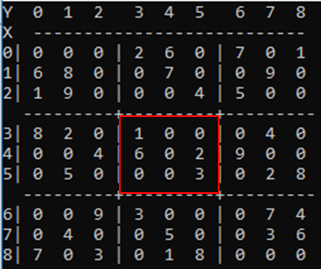
Checking the square pt 2
Coordinates to check =
3,3 3,4 3,5
4,3 4,4 4,5
5,3 5,4 5,5
For any of the coordinates above, we are required to check all the others.
To make this simple, lets find the top left index, because then we can just use a nested for loop.

Slide 16
Checking the square pt 3
Coordinates to check =
3,3 3,4 3,5
4,3 4,4 4,5
5,3 5,4 5,5
Example:
I want to check 4,4, so I need to find a way to mutate 4,4 into 3,3.
Simple answer = just subtract one from x and y, but that won’t work because what if we want to check 3,4?
Modulus is the answer!

Slide 17
Checking the square pt 4
Coordinates to check =
3,3 3,4 3,5
4,3 4,4 4,5
5,3 5,4 5,5
Example:
3 % 3 = 0 => 3-0=3
4 % 3 = 1 => 4-1=3
5 % 3 = 2 => 5-2=3
We have used modulus to mutate any of these values into the proper form!

Slide 18
Checking the square pt 5
Coordinates to check =
3,3 3,4 3,5
4,3 4,4 4,5
5,3 5,4 5,5
Example:
for(i= row - row % 3; i < row - row % 3 + 3; i++)
What does i equal in the above loop if my row input is 5? 2? 6?
More specifically, what is it for 3, 4 and 5?

Slide 19
SudokuBoard.FindLegalDigits()
This method will be used within your solving algorithm to determine all possible digits for any given slot.
Start with a list filled with 1-9
For all in row -> remove from list
For all in column -> remove from list
For all in square -> remove from list
Return list which is all remaining

Slide 20
SudokuBoard.SudokuBoard(string)
Overloaded constructor for the board, reads a single line from a file in the following format:
4.....8.5.3..........7......2.....6.....8.4......1.......6.3.7.5..2.....1.4......
First 9 characters is the first row, second 9 characters is the second row, etc.
Each line of file is a new board
Either let the user pick a line #, or just randomly select one upon loading.
Store the board in the “Board” property as an char[9,9]

